Slide 1
Machine Learning in Practice I
Lecture 6
Antal Jakovac, 2025

Slide 2
Data modelling

Slide 3

Data modelling
task: find out the selective/descriptive features
depends both on the dataset and the context
selective: constant on a class, descriptive: changes within a class
class depends on the context
finding the selective coordinates is the main challenge
we start with simple 1D classification problems, and generalize to several dimensions

Slide 4
One dimensional dataset classification

Slide 5
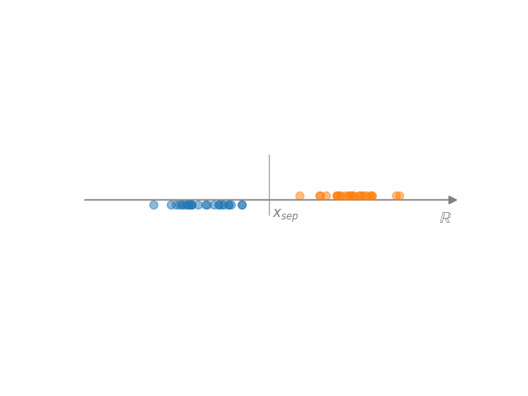

One dimensional dataset
Simplest basic case: characterization of one-dimensional data
  data → (numbers for analytic characterization)
Separation of two 1D sets
  assume that in given sections belong (approximately) to a single class
  basic case: one section → A, other section → B
  if the two sets are separated (hard margin)
  overlapping case? → no perfect solution

Slide 6
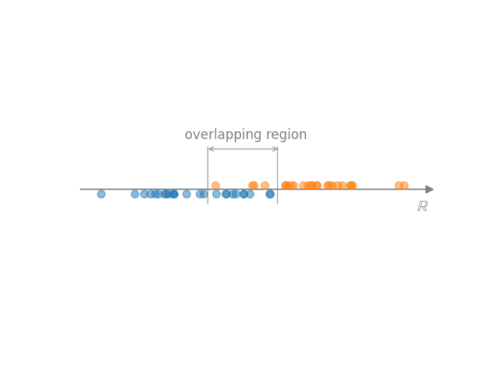
One dimensional dataset
overlapping regions → no perfect solution (heuristics)
  choose somewhere in the
  overlapping region (eg. midpoint)
  define en error function in the overlapping region, e.g.
  p=1 (“hinge loss”) → median, p=2 → mean
  we can weight the points

Slide 7
One dimensional dataset
Another approach: treat the problem as a regression
  define a function
  a classification can always be translated to regression
  simplest: linear relation f(x)=ax+b
  probabilistic interpretation:
  logistic map, probability of belonging to class B
  loss function:

Slide 8
One dimensional dataset
# Python function minimization
import numpy, matplotlib
def P(p, x):
a,x0=p
return np.exp(a*(x-x0))/(1+np.exp(a*(x-x0)))
def loss(p, A, B):
loss = np.sum([P(p,a)**2 for a in A])
loss += np.sum([(P(p,b)-1)**2 for b in B])
return loss
p0 = [1, 1] # initial guess
params = (A,B) # values of a, b
res = minimize(loss, p0, args=params)
a,x0 = res.x
Another approach: treat the problem as a regression
  define a function
  a classification can always be translated to regression
  simplest: linear relation f(x)=ax+b
  probabilistic interpretation:
  logistic map, probability of belonging to class B
  loss function:

Slide 9
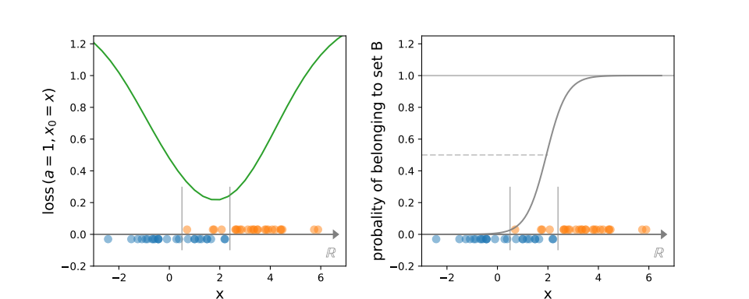
One dimensional dataset
Another approach: treat the problem as a regression
  logistic map, probability of belonging to class B

Slide 10
Decision trees

Slide 11
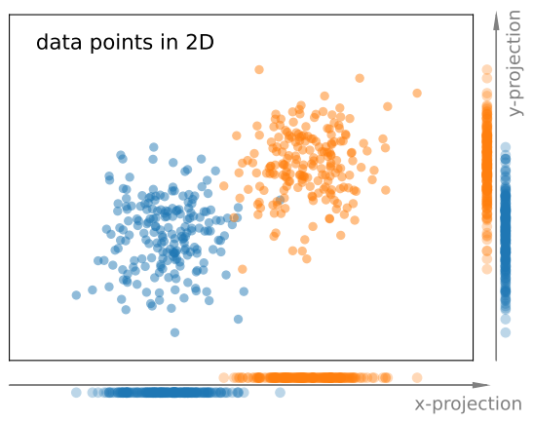
Tree based methods
The generalization to multiple dimensions is not simple
  in 1D the coordinates are unique
  in multidimensional case we can optimize the coordination → features
  simplest case: use original coordinates
  usually the original coordinates are not
  equally useful
  (c.f. image → x coord separates more)
  choose that coordinate that leads to the
  smallest total impurity!

Slide 12
Tree based methods
Decision tree (DT)
always converges, but may result in fragmented divisions
set 1
divide it into two along the coordinate where the
total impurity is smallest
start from an impure set
set 2
repeat until pure or max number

Slide 13
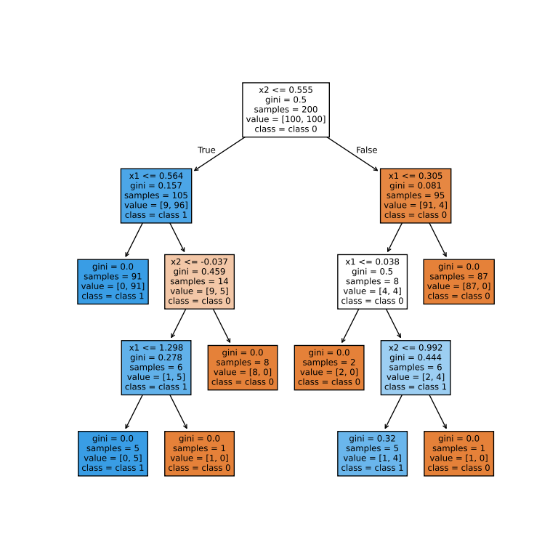
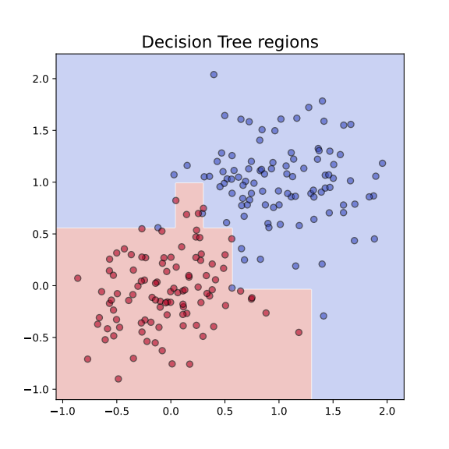
Tree based methods
Decision tree (DT) example
  two 2D sets
pros:
  simple
  interpretable
cons:
  not robust enough
  (→ irregular shape)

Slide 14
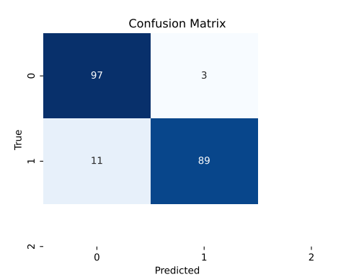
Tree based methods
Decision tree (DT) example
  two 2D sets
pros:
  simple
  interpretable
cons:
  not robust enough
  (→ irregular shape)
  use fixed depth!
  accuracy: train: 100%, test: 92.5%

Slide 15
Tree based methods
Decision tree (DT) technical solution in Python → github
# Decision Tree example
from sklearn.tree import DecisionTreeClassifier
from sklearn.metrics import confusion_matrix
# 1. get or generate data and labels
# 2. Fit a decision tree
clf = DecisionTreeClassifier()
clf.fit(data, labels)
# 3. use for prediction
pred_labels = clf.predict(other_data)
#4. confusion matrix
cm = confusion_matrix(labels, pred_labels)

Slide 16
Ensemble methods

Slide 17
Ensemble methods
Decision tree → too specific for a sample
Possible solution: use ensemble of methods
ways of improvement
  bagging (Bootstrap AGGregatING) → bagging, random forest
  boosting → adaptive boosting, gradient boosting
  other methods → extra trees, isolated forests, oblique trees

Slide 18
Bagging
Idea:
  train several models in slightly different datasets
  each dataset contains the same number of data from the database, but some of them are missing, some appear multiple times
  combine the results → regression: average, classification: majority vote
Benefits:
  lowers variance
  increases robustness

Slide 19
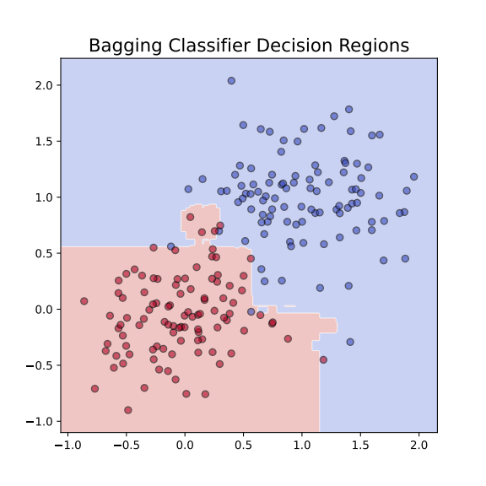
Bagging
# Bagging example
from sklearn.ensemble import BaggingClassifier
from sklearn.tree import DecisionTreeClassifier
from sklearn.metrics import confusion_matrix
# bagging based on decision tree
base_tree = DecisionTreeClassifier()
clf = BaggingClassifier(
estimator=base_tree,
n_estimators=50, # number of trees
max_samples=0.8, # each tree sees 80% of data
bootstrap=True, # sampling with replacement
random_state=42
)
clf.fit(X,y)
# 3. use for prediction
pred_labels = clf.predict(other_data)
#4. confusion matrix
cm = confusion_matrix(labels, pred_labels)
Code: github

Slide 20
Random forest
Idea: in addition vary the used parameters, too
  train several models in slightly different datasets
  each model uses selected data and selected parameters
  combine the results → regression: average, classification: majority vote
Benefits:
  more robust than simple bagging
  can be used to rank parameters by their significance, i.e. which contributed more to the final decision

Slide 21

Random forest
# Random Forest example
from sklearn.ensemble import RandomForestClassifier
from sklearn.metrics import confusion_matrix
# bagging based on decision tree
# Train Random Forest
clf = RandomForestClassifier(
n_estimators=100, # number of trees
max_depth=None, # let trees grow fully
random_state=42 # random generator seed
)
clf.fit(X, y)
# 3. use for prediction
pred_labels = clf.predict(other_data)
#4. confusion matrix
cm = confusion_matrix(labels, pred_labels)
2D case
accuracy: 94%

Slide 22
Boosting
Idea:
  calculate a series of decision trees
  each focuses on the points where the previous one fails
  combine weighted sum of all of these models
Adaptations: AdaBoost, Gradient Boosting (GBM), XGBoost, …

Slide 23

Boosting
# AdaBoost example
from sklearn.metrics import confusion_matrix
from sklearn.ensemble import AdaBoostClassifier
# boosting based on decision tree
# Train AdaBoost model
boost = AdaBoostClassifier(
estimator=DecisionTreeClassifier(max_depth=2),
n_estimators=50,
learning_rate=1.0,
random_state=42)
boost.fit(X, y)
# 3. use for prediction
pred_labels = boost.predict(other_data)
#4. confusion matrix
cm = confusion_matrix(labels, pred_labels)
2D case
accuracy: 94%

Slide 24
END OF LECTURE 6

